Slide 1
Network effects on job-education matching of international students in Atlantic Canada
Ather H. Akbari (Saint Mary’s University)
Nicholas Manuel (Saint Mary’s University)
Presentation prepared for 28th National Metropolis Conference - Halifax, March 11, 2026 (Workshop B3)
Notes:
Go very quickly thru the first 4 slides

Slide 2


Acknowledgements
Partners and supporters

Slide 3
Acknowledgements (contd.)
Project steering committee
Stephen Coyle – Group ATN
Lauren Cullen – Saint Mary’s University
Peter Halpin – Association of Atlantic Universities
Byron James – Atlantic Colleges Atlantique
Sarah McRae – Government of New Brunswick
Lisa O’Connell – Maritime Provinces Higher Education Commission
Jennifer Porter – Memorial University of Newfoundland
Jerry Wang – University of Prince Edward Island
Research Team
Ather H. Akbari
Stephen Coyle
Adou Kouakou
Research Assistants
Mohshinul Karim (MAE program)
Maya Saradammal (MAE program)
Ambreen Tabassum (MAE program)

Slide 4
Population in Atlantic Canada, 1996-2024
Source: Statistics Canada. Table 17-10-0009-01 Population estimates, quarterly
Notes:
Aging at a faster rate.
After decades of stagnation or decline, population in Atlantic Canada has increased remarkably over the past few years. However, there are still concerns about aging of population, resulting from declining natural growth of population happening in Atlantic Canada at a faster rate, which has economic implications for the region. The median age across Canada is 40.6 years. In Atlantic Canada it ranges from a low of 41.9 in Prince Edward Island to 48 in Newfoundland and Labrador. And, despite good population growth over the past decade or so, other parts of Canada have been increasing faster. The Atlantic share of national population in 1996 was 8%; in 2023 it was 6.5%.
Aging population has its impact on economic development. Strategies for growth in the region embody demand for a well-educated and skilled labour force, to encourage the right kind of development. This is more difficult to sustain with an aging population.

Slide 5
Key source of economic growth
Growth in capital stock:
Physical capital: investment in machinery, equipment, infrastructure
Human capital: growth in knowledge, productivity and innovation through investment in education
Challenge: Natural decline of population causing fall in Canadian students enrolling in post-secondary institutions
One solution: Increase enrolments of international student and retain them after study
Notes:
Human capital growth more important but challenging due to natural decline of population falling university aged population, necessity of international students.
Enrolment of Canadian students in public postsecondary institutions across Canada declined by 37,065 from the 2010/2011 academic year to 1,784,181 in 2019/2020, likely due to population decline. From 2010 to 2019, the number of international students enrolled in Canadian public postsecondary educational institutions more than doubled from 142,200 to 388,800, and their share of total postsecondary student enrolments increased from 7% to 18% (Crossman, Choi, & Hou, 2021). Development strategies are based on a labour force that can sustain continuous growth, including increasing the number of international students at the region’s universities and colleges, and encouraging them to seek permanent resident status at the end of their studies and join the labour force. These students have Canadian qualifications, are fluent in one or both official languages, and are familiar with the culture.

Slide 6
Study permit holders in Atlantic Provinces, 2000-2024 (December 31)

Slide 7
Objective of the survey
To understand how social integration of international students during their studies affects the possibility of their finding jobs in their field of study.
Notes:
Survey addressed:
The education they receive, campus services, social interactions, employment, and the immigration process.
An in-depth analysis of their experiences is imperative to their retention in the region after finishing their studies.

Slide 8
Importance of the study
Finding jobs in the field of study is important for:
  Personal development and success of the individual
  The best return to education received
  The overall productivity of labour force
Notes:
Development and success through skill development (develop technical and soft skills), networking opportunities (chance to connect to professionals in the field more easily), faster on the job training.
Returns to education received: Through faster adaptation on the workplace.
Better productivity of labour force benefitting the society.
In case of international students it is more important because international student attraction and retention initiatives aim at fulfilling gaps in particular fields. More targeted towards filling labour market gaps. (Recent policy changes now require post-secondary institutions to recruit students in areas where there are labour market needs.

Slide 9
Social experience during study and job-education matching
On-campus social experiences reduce the search cost of finding job in one’s field of study through:
  Networking opportunities with:
    Classmates who are working towards the same goal,
    Professors with connection in the relevant industry/sector,
    Industry professionals.
    These connections can lead to job referrals and insider information about job openings.
Notes:
Read below:
Social experiences during study can create a supportive environment that enhances employability and increases the chances of finding relevant job opportunities.
Teamwork skills: Participating in group projects and social events fosters teamwork and collaboration skills, which are highly valued by employers. Demonstrating these skills can make candidates more attractive for relevant positions.

Slide 10
Social experience during study and job-education matching (contd.)
On-campus social experiences allow to develop:
  Teamworking skills where team members focus to develop a common set of skills.
  Interaction with classmates who are working towards the same goal. (teamworking skills).
  Interaction with professors with connections in the relevant industry/sector.
  Interaction with industry professionals.
Notes:
Read below
Social experiences during study can create a supportive environment that enhances employability and increases the chances of finding relevant job opportunities.
Teamwork skills: Participating in group projects and social events fosters teamwork and collaboration skills, which are highly valued by employers. Demonstrating these skills can make candidates more attractive for relevant positions.
These connections can lead to job referrals and insider information about job openings.

Slide 11
Notes:
Job finding process has both costs and benefits which the Figure shows. Probability is generally lower for international students because, relative to domestic students, they are at an information disadvantage.
Within the framework of Stigler’s information theory, imperfect information in the job market leads to job search which has both benefits and costs. Costs are mostly in terms of wages foregone when the individual decides to engage in more search, while the benefit is mostly in terms of higher wage when an extra search takes place. In the present context: both domestic and international students look for jobs in their field of study and are willing to forego current wage offer in search of a better offer that matches their field of study. However, the cost of search is higher for international students as they are at a greater information disadvantage than domestic students and also lack the network connections. Hence, they are likely to end their job search earlier than domestic students. As a result, there is a greater chance they may end up taking a job not related to their field of study.

Slide 12
Who was the survey administered to?
The target population for the survey was 68,845 post-secondary students who enrolled at Atlantic institutions between 2017 and 2023.
There were 3,584 valid responses to the questionnaire, roughly equally split between males and females and over a wide range of ages.
About 60% had received their study permit within three months of application, and few had delays in starting programs as a result.
The Canadian application process is generally comparable to, if not rather easier than, those in other countries.

Slide 13
Social interaction
More than 70% were satisfied with their interactions with domestic students, although some admitted it was easier to make friends with other international students.
About one-third reported social isolation on campus.
About a quarter reported interaction with families off-campus, with most describing this experience as warm and welcoming.
Notes:
We asked about:
their interaction with fellow domestic students.
If they had a study group while studying
Composition of study groups
If they interact(ed) socially with members of their study group
If they were hosted by a family off campus
If they felt social isolation on campus. [Social isolation on campus felt due to language and cultural barriers. (Check)]

Slide 14
Sample
We restrict the sample to respondents who are still in Canada, and who were not pursuing another post-secondary education credential at the time of the survey.
2,078 respondents remain
Aggregate respondents into 6 regions of origin (South Asia, East Asia, Middle East, Sub-Saharan Africa, Latin America, and West).
Aggregate fields of study into 6 different categories (Arts, Business, STEM, Hospitality/Tourism, Trades, and Other).
Our dependent variable of interest is whether they report working in an occupation that is related to their field of study. (56.7% do)
Notes:
After some data cleaning, we were left with 2,078 respondents for this part of the study.

Slide 15
Social Ties Index
Using Principal Component Analysis (PCA), we create a “Social Ties Index” that aggregates responses related to feelings of social inclusion during their studies. Respondents indicated:
1. Whether they found it easy to make friends. (69.88%)
2. Whether they experienced social isolation on campus. (30.88%)
3. Whether they are still in contact with members of their on-campus study group. (46.22%)
4. Whether they socialized with members of their on-campus study group. (46.4%)
5. Whether they report difficulties with making friends as a factor that negatively affected their academic performance. (15.91%)
One unit increase in the index represents a one standard deviation
increase in strength of social ties.

Slide 16
Study Group Composition
Respondents also indicate whether their on-campus study group (if applicable) consists:
Exclusively of other international students. (23.51%)
Exclusively of domestic students. (1.46%)
Both other international students and domestic students. (37.16%)
We use a fourth category for respondents who indicated that they had no study group. (37.87%)
We create a variable consisting of the number of fellow respondents from the
same country of origin who studied in the same field, in the same year,
at the same institution. (Mean=2.08)
Home Country Classmates

Slide 17
Model
We run a set of logistic regressions to obtain the log odds of working in their field.
Control for region of origin, field of study, level of education, gender, age, years since graduation, citizen/permanent resident status, self-reported GPA, region of Canada currently residing in, whether they resided in Canada before starting their program of study, home country classmates, study group composition, and social ties index.
Notes:
Go quickly.

Slide 18
Summary
Strong social ties predict the likelihood that a former international student from an Atlantic Canadian institution works in a job related to their field of study.
Who they network with matters:
  Evidence that international student only study groups predict lower likelihoods of working in jobs related to their field of study, relative to no study group or study groups that contain at least some domestic students.
  Evidence of no “direct” effect of domestic students in finding a job. Their effect is through field of study (field sorting effect).
Notes:
This finding is consistent with the literature that has documented better labour market outcomes for individuals who had strong social connections during the course of their education and shows that this holds true for international students.
This result is consistent with the literature that has documented that migrant-dominant social networks may reduce search frictions for jobs that are poor matches for an immigrants’ background, increasing the likelihood that they will work in such jobs.
We also find that contact with domestic students does not appear to raise an international student’s likelihood of working in their field. Where a positive correlation between domestic student contact and working in one’s field is found, this is entirely accounted for by fields of study, indicating that international students at programs with relatively higher demand in labour markets tend to have more contact with domestic students. The lack of a positive effect of domestic student contact is perhaps surprising, since theoretically it would be expected that contact with domestic students would help with transmitting cultural norms, improving English/French language skills, and reducing job search frictions in segments of the labour markets that disproportionately employ domestic student graduates. Domestic students seem to help international students find jobs, but this effect is actually due to shared fields of study rather than their domestic status. Controlling for field of study removes the apparent advantage, highlighting the importance of job-field relevance in networks.

Slide 19
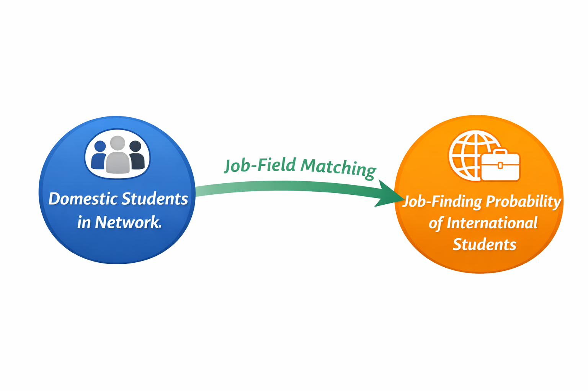
Notes:
So, when we refer to job-education matching, we generally are referring to alignment of education levels with skill levels (TEER 0-5). However, what results of this study are suggesting is Job-field matching and not so much job-degree matching. Presence of domestic students helps field sorting.

Slide 20

Thank you all!

